Slide 1


Detailed Project Report On “Axon Healthcare Analytics”
Presented By: Group 6
Akash.S
Sahith.Nayana
Harshini.J.Prakash

Slide 2
Agenda
INTRODUCTION
ABOUT THE CLIENT
OBJECTIVE OF THE PROJECT
KPI FOR THE PROJECT
UNDERSTANDING DATASET
CHALLENGES FACED
DATA CLEANING AND DATA MODELING
DATA VISUALIZATION USING EXCEL
DATA VISUALIZATION USING TABLEAU
DATA VISUALIZATION USING POWERBI
SQL SCRIPTS
CONCLUSION

Slide 3






INTRODUCTION
The aim of the “Healthcare Analytics” project was to develop interactive visualizations of patient data provided by the client using “Electronic Medical Records (EMR)” to provide actionable insights for healthcare providers and administrators.

Slide 4

About Axon Healthcare-EMR Software Provider
Axon healthcare is a health technology company dedicated to transforming how clinics, hospitals, and healthcare providers manage patient data. By offering secure, Scalable, and user-friendly electronic medical records (EMR) software, axon healthcare helps healthcare organizations streamline operations, enhance patient care, and ensure compliance with medical data regulations.

Slide 5
Objective of the project
Axon Healthcare is facing challenges in understanding the performance, patient outcomes, and financial health. Since hospital collects large volumes of data related to patient admissions, treatments, billing, insurance providers, doctor’s workload etc. the management team lacks a consolidated view to make timely, data-driven decisions.
The hospital leadership has requested a Healthcare Analytics Report that will include
1. Improve Patient Care Outcomes
2. Optimize Operational Efficiency
3. Revenue Generated To The Hospital
4. Support Strategic Decision Making Expected Deliverables

Slide 6

Key Performance Indicators
Total Patients
Total Doctors
Total visits
Average Age
Total revenue
Follow up rate
Top 2 diagnosis
Cost of medication
Doctor’s workload
State wise insurance provider
Count of monthly visits
Count of patients In each hospital
Hospital revenue
Treatment status of patient
Count of patients having chronic conditions

Slide 7
Understanding Dataset
Healthcare dataset summary:
Purpose of the Dataset: To provide a comprehensive view of patient demographics, medical background, and administrative details that support healthcare analytics, reporting, and decision-making.
Key Components of the Dataset
Patient Demographics
Contact & Location Details
Medical Information
Insurance & Administrative Data
Data Characteristics: Contains multiple data types like text, numeric, and categorical and date
Analytical Possibilities:
Patient segmentation (age, gender, geography)
Chronic disease trend analysis
Insurance utilization and revenue insights
Identifying high-risk patient groups
Building dashboards for operations, clinical, and financial decision support
Overall Insight: This dataset provides a strong foundation for building a holistic healthcare analytics report, combining demographic, clinical, revenue related and insurance-related data to generate meaningful insights for hospital management.

Slide 8

Challenges faced in the process:
Raw dataset had inconsistent value which was overcome by data cleaning using power query.
Faced challenge with data modeling as most of the worksheets had no common column.
Importing of csv file to SQL
Combining of multiple excel dashboard into one single worksheet

Slide 9
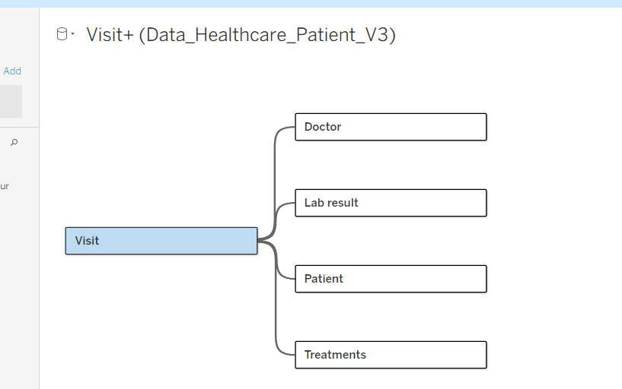
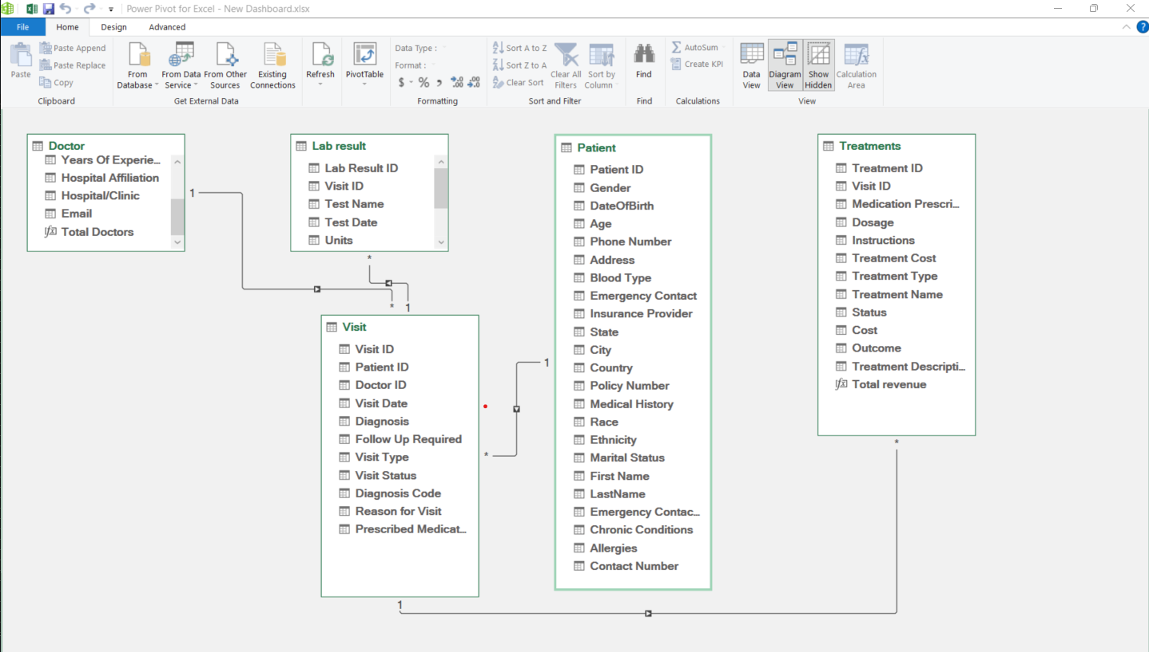
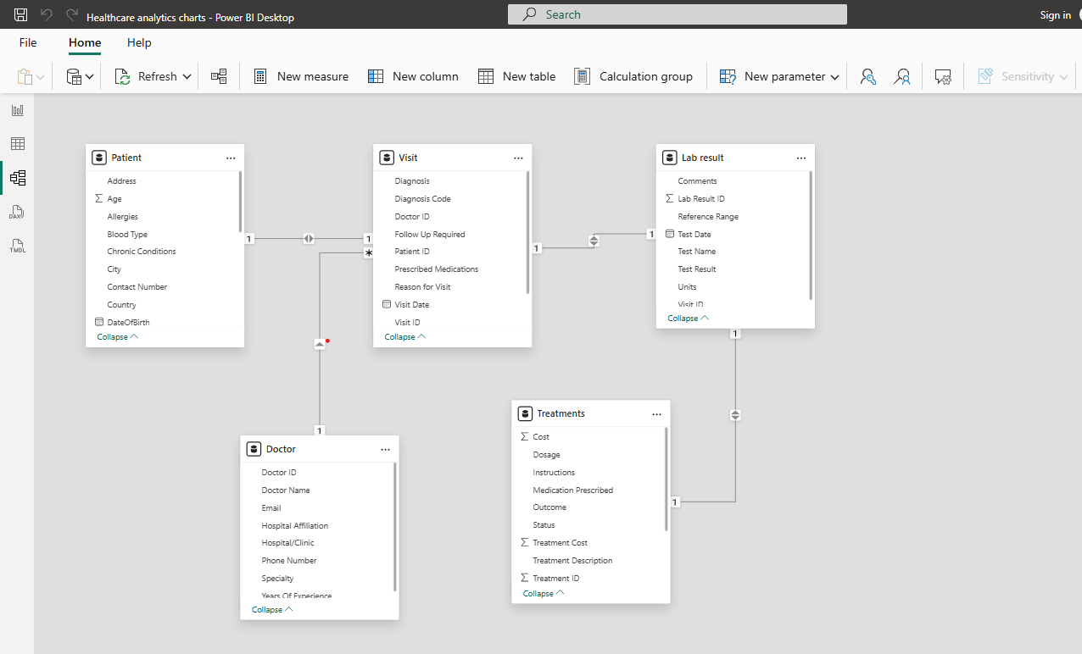
Data Cleaning & Data Modeling
Data cleaning was performed using Power query and power pivot where we created measures for total patients, total doctors, average age, total visits, total revenue
Data modeling was done using power Pivot, Power BI and tableau
Data modelling in Tableau
Data modelling in Power Pivot
Data modelling in Power BI

Slide 10
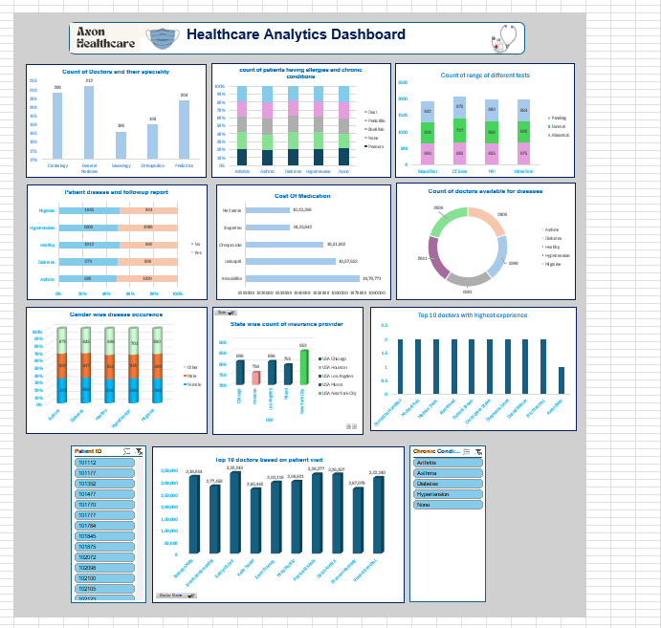
Data Visualization using Excel
Hyperlink for excel dashboard

Slide 11
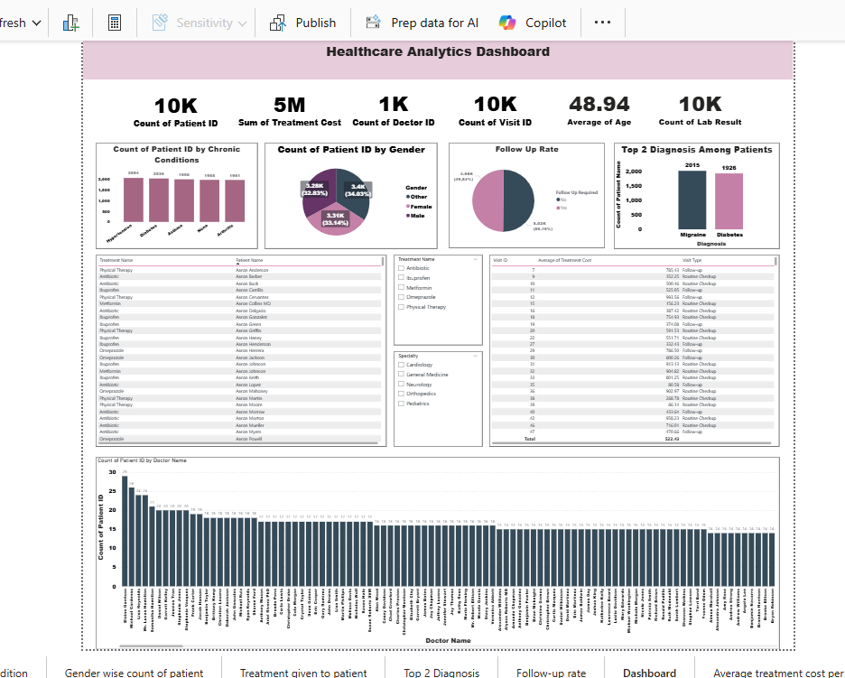
Data Visualization Using Power BI
Hyperlink to Power BI Dashboard

Slide 12
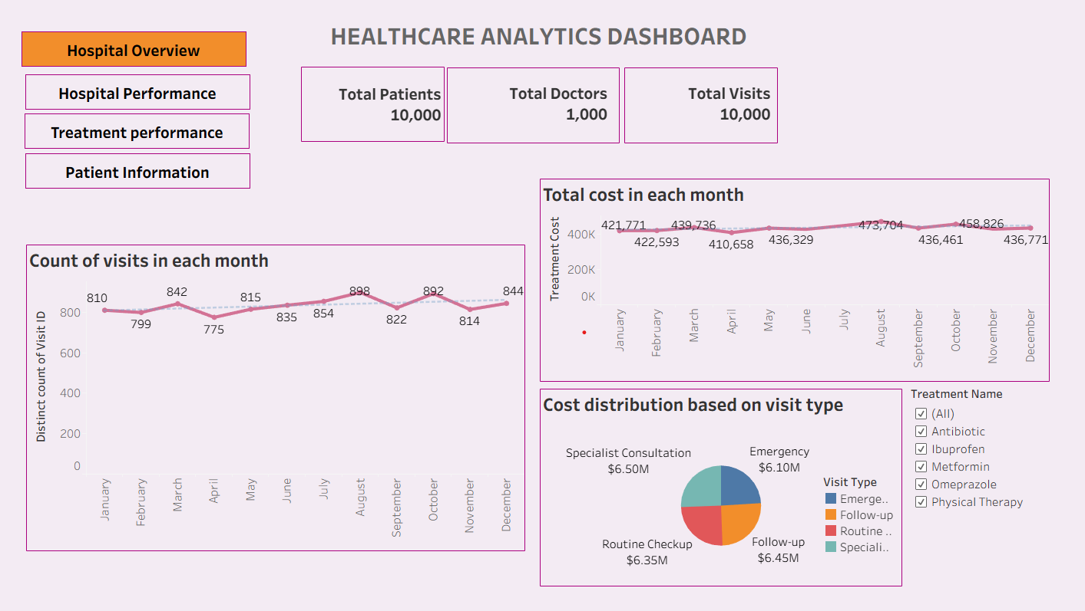
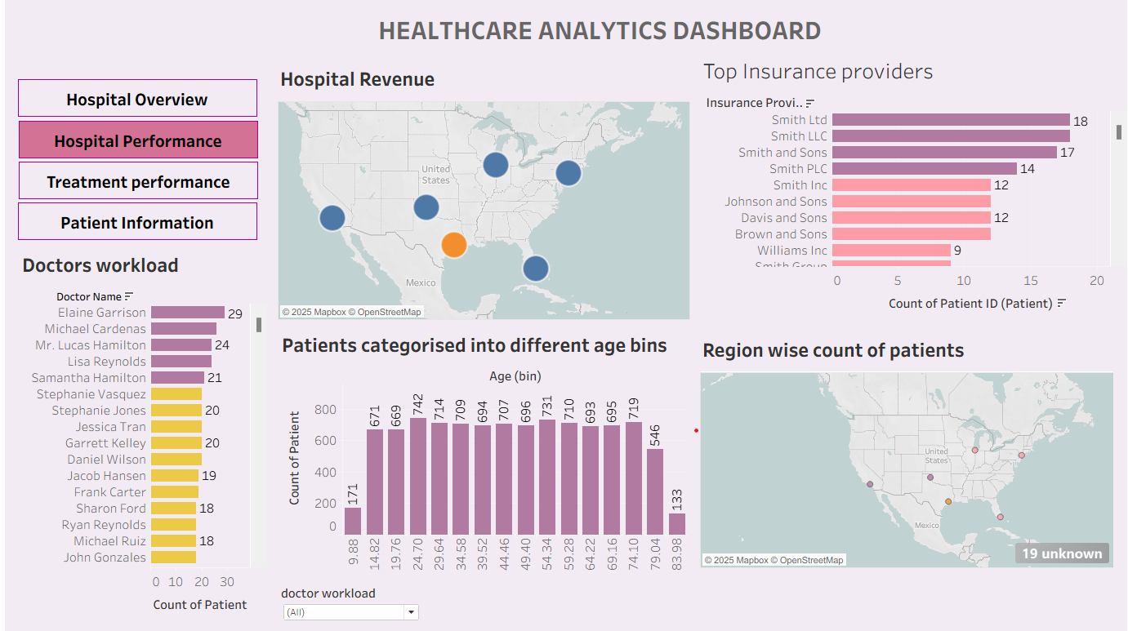
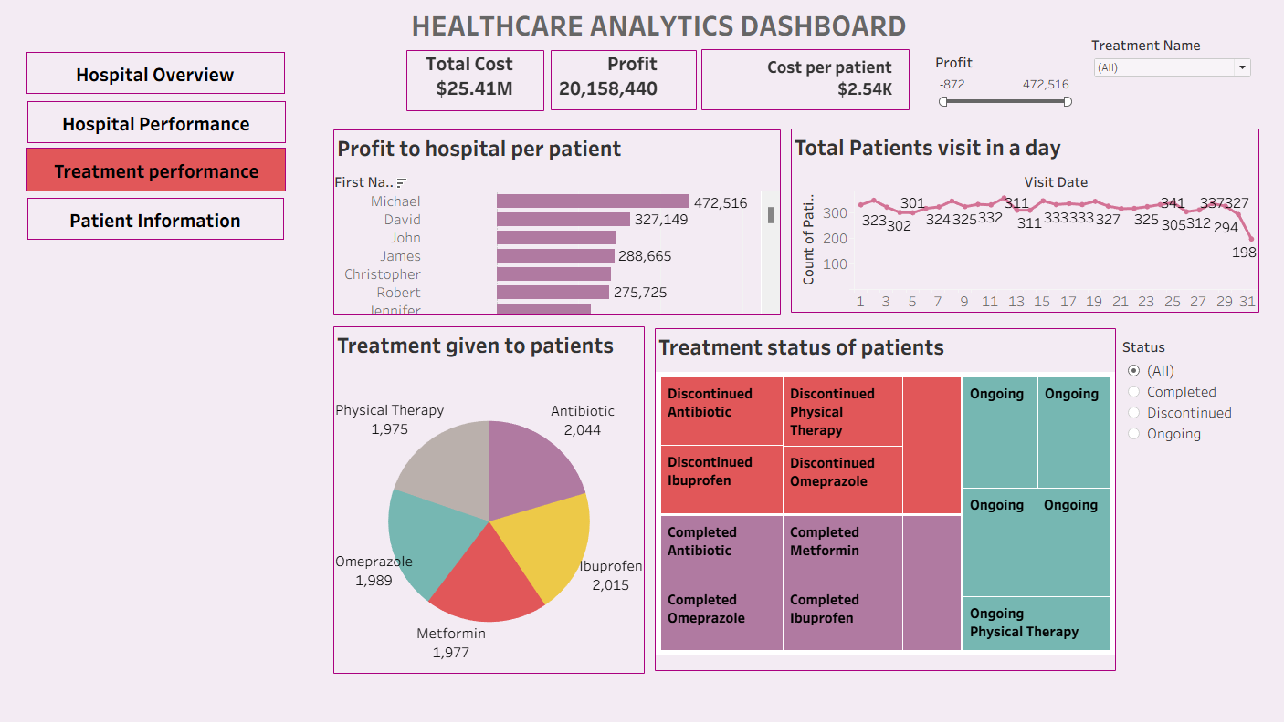
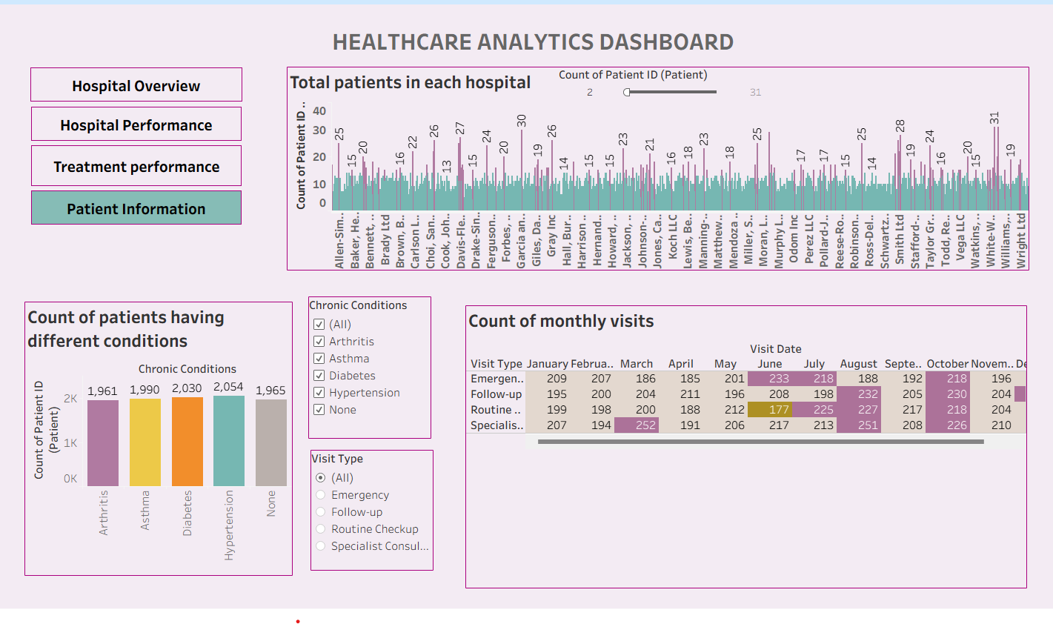
Visualization Using Tableau

Slide 13
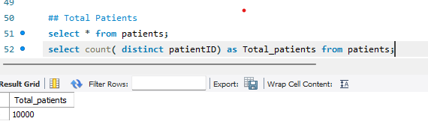
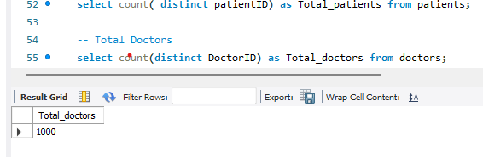
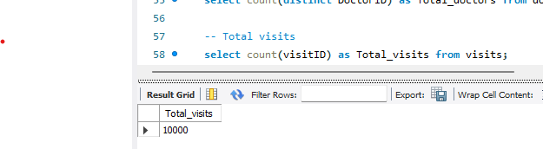
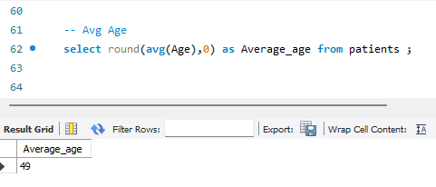
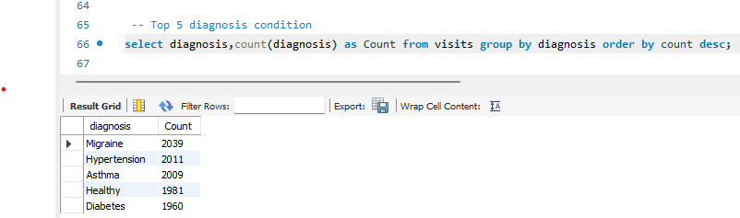
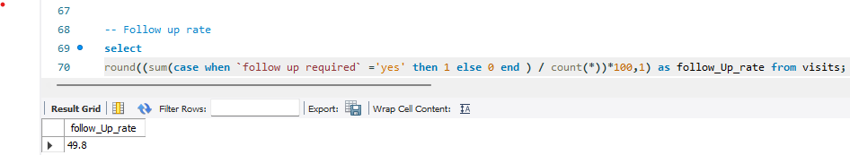
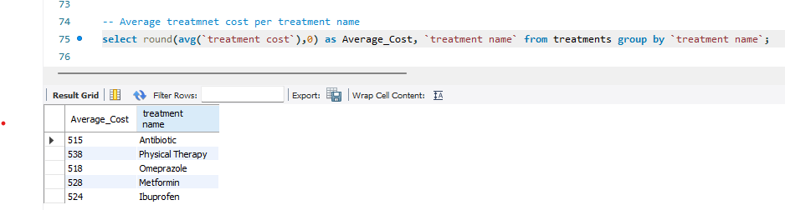
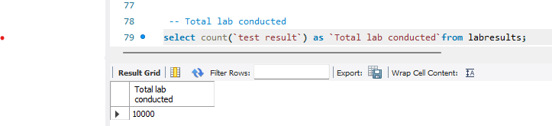
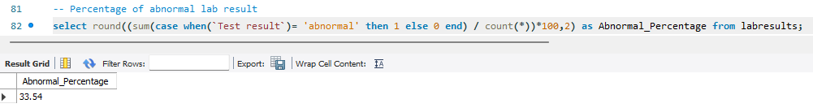
SQL Queries For the KPI’S

Slide 14
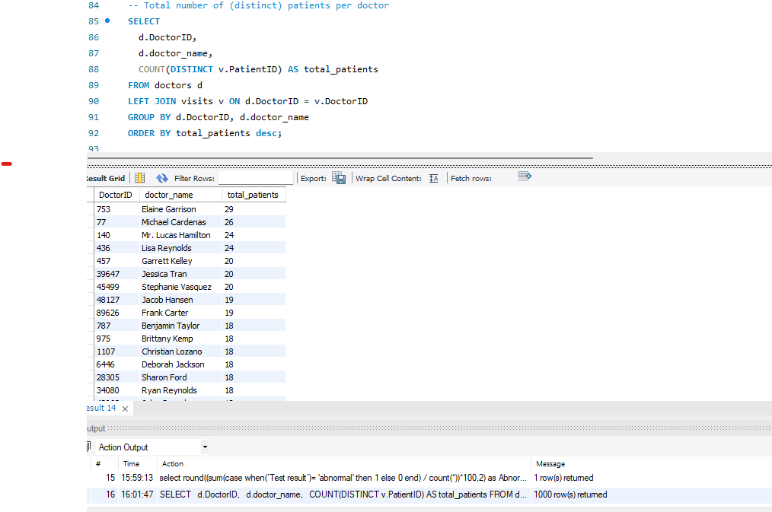
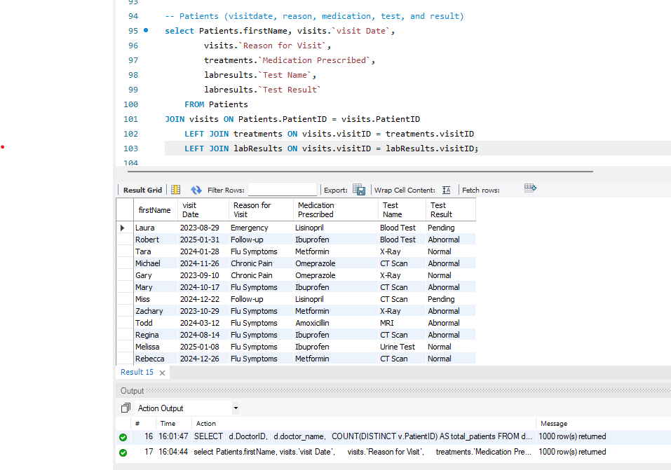

Slide 15
CONCLUSION
The above healthcare analytics report provides a comprehensive view of key hospital management, clinical, and financial metrics, enabling data-driven decision-making across the organization by integrating datasets related to patient demographics, appointments, admissions, diagnostics, and financial performance of the hospital
The analysis highlights important trends, bottlenecks, and improvement opportunities.
The dashboards and visualizations developed in this project help users to quickly identify high-risk areas and monitor service quality.
Insights such as variations in patient volume, treatment outcomes, and revenue patterns support strategic planning and continuous performance improvement.
Overall, this analytics solution improves transparency, supports evidence-based decisions, and empowers healthcare stakeholders to enhance patient care, optimize operational efficiency, and drive better organizational outcomes.

Slide 16

Thank You Have A Nice Day
Akash.S akashsakash111@gmail.com
Sahith.Nayana sahithnayana@gmail.com
Harshini.J.Prakash harshinsjp097@gmail.com

